Slide 1

Virtual psychiatrist
EMPOWERING MINDS,
FOSTERING WELLNESS

Slide 2
Virtual psychiatrist
Team Members
Anss Abrar
Hizar Sajjad

Slide 3

Vision
"Embracing innovation and accessibility, our vision for Mental Mind is to pioneer a digital oasis for mental well-being. By seamlessly integrating personalized care and insightful analytics, we aspire to empower individuals on their journey to emotional resilience and holistic health."

Slide 4

Problem
Rising Suicide Rates
"Limited Accessibility to Mental Health Support"
"Barriers to Quick and Confidential Help"
"Stigma and Affordability Hindering Support"
"Scarcity of Mental Health Experts"
"Addressing Gaps in Mental Health Assistance"
"Need for Confidential, Accessible Support System

Slide 5
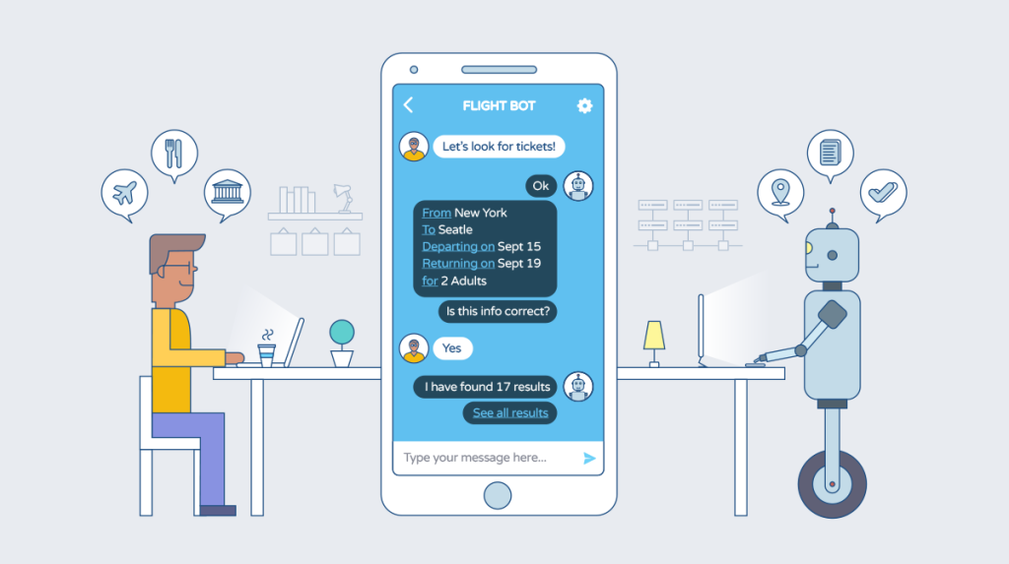
Solution
Cutting-Edge Mental Health Assistant
Immediate, Empathetic Mental Health Support
Safe and Confidential Mental Health Space

Slide 6

Objectives
Develop a Virtual Psychiatrist Chatbot
Provide Mental Therapy and Support
Maintain User Privacy and Confidentiality

Slide 7


Modules
Module 2: Mental Health Chatbot
Module 1: App UI and User Registration
Module 3: Model Deployment in App
Module 4: Chat History Database

Slide 8





Architecture
Privacy and Security Measures
User Login/Registration
Authentication
Chat Screen
Therapy and Support
Chat History Database

Slide 9

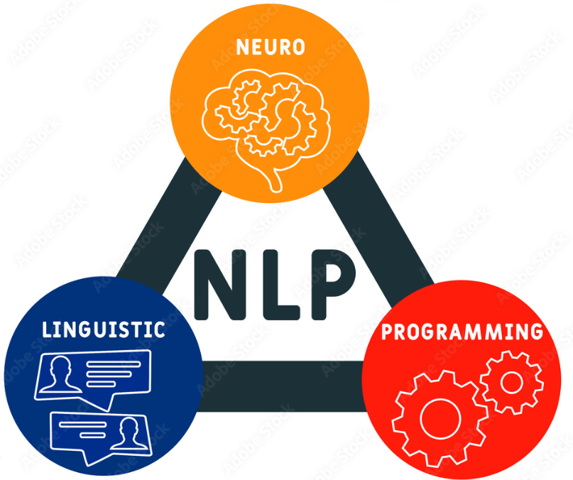




Tools & Technologies
VS code

Slide 10
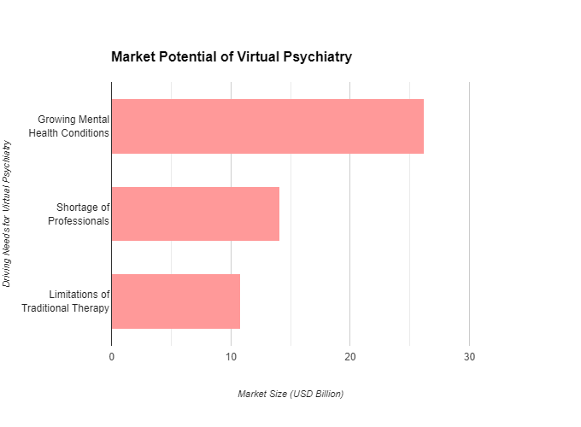
Market
Pakistan has only one psychiatrist for every 10,000 people, and one child psychiatrist for four million children.
There are only four major psychiatric hospitals and 20 units attached to teaching hospitals in a country of 163 million people.

Slide 11

Conclusion
"Committed to revolutionizing mental health care, our virtual psychiatrist platform seeks to provide a seamless and user-friendly experience for managing personal well-being. Join us in reshaping the future of mental health management, one virtual session at a time."

Slide 12


THANK YOU
CONTACT US:
anssabrar11@gmail.com
hizarsajjad@gmail.com

